Slide 1
Test Generator
Developers:
dhruvesh panchal
Niteen pawar
Guidance By :
Amar Panchal

Slide 2
Problem Definition
As test series plays an important role in preparation of any exam so setting up question paper becomes a crucial task
But setting papers frequently becomes time consuming and boring job
So as to overcome the problem and automate the task we have attempted to make a Desktop Software which will do the job for YOU!
The details of project are as follows…

Slide 3
Technology Used
1) JAVA (Fronted + Backend)
2) Ms-Excel (used as database to store questions and retrieve them)
JAVA :
JFrame (GUI)
File Handling
fillo (jar file to communicate with excel by writing querys in SQL)

Slide 4
How To Use
1) Open Test Generator
2) Select the excel file which contains questions
3) Then select total no of question for particular marks question
4) And then after that many question would be generated on the notepad and pop up on the screen.

Slide 5
How To Add Questions ?
1) Open Excel
2) In the first column add the serial no
3) Then add the question in the adjacent column and its corresponding marks.
NOTE:
The columns must be in the following sequence:
1)Index
2)Questions
3)Marks

Slide 6
What’s Going On In The Backend?
Initially all the question are taken in an ArrayList<String> (different list is used for different marks of question)
Next is to take input from the user , like for particular mark question how much questions to generate
Then that many random number (here secure random is used) are generated and using that no as the index for list question are selected ( here while generating random number care is taken that number does not exceeds the count of question)

Slide 7
Code
Please go to the following link to download the source code
https://drive.google.com/drive/folders/1irYzlsqQxEyq7IVZpNDkex8Dh_fNwybn?usp=sharing
If you find any bug or issue please let us know about it and also tell if you want to add any particular feature to it or make it more better ☺
Video of working project is attached …

Slide 8
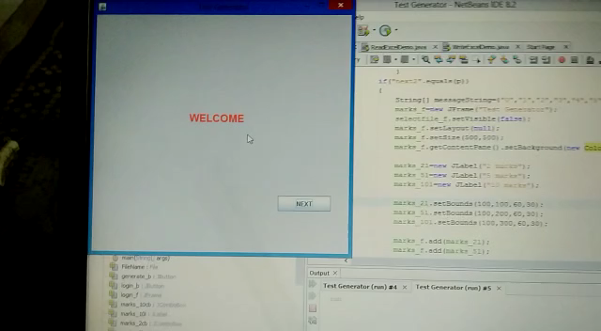
Here username and password is static.
Username : root
Password : root

Slide 9
THANK YOU!
Developer’s Info :
Dhruvesh Panchal – 8779762657 (Vidyalankar Inst of Tech)
Niteen pawar – 7039463921 (Vidyalankar Inst of Tech)

